Slide 1
Vision Based Robotic Hand Gripping And Turning
Supervisor: Prof. Shyam Kamal
Group Members: Vaibhav Agarwal (19085094)
Preety Sarwa (19085068)
Vasu Bansal (19085095)

Slide 2
ABSTRACT
The problem of enabling a robot to autonomously gripping and turning doorknob.
A challenging perception and control problem.
Rather than building a full 3d model of the door --> use of computer vision.
Use image for “3d door-knob locations”
Define a movement for the robot end-effector (hand) that successfully grips and turns the doorknob.

Slide 3
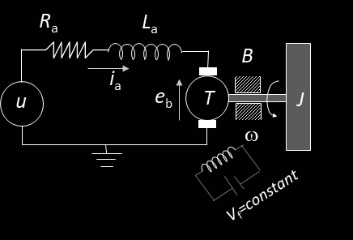





ARMATURE CONTROLLED DC MOTOR
OF ROBOTIC ARM
I) Electrical Subsystem (loop Method)
II) Mechanical Subsystem (MOTOR)
III) Power Transformation

Slide 4
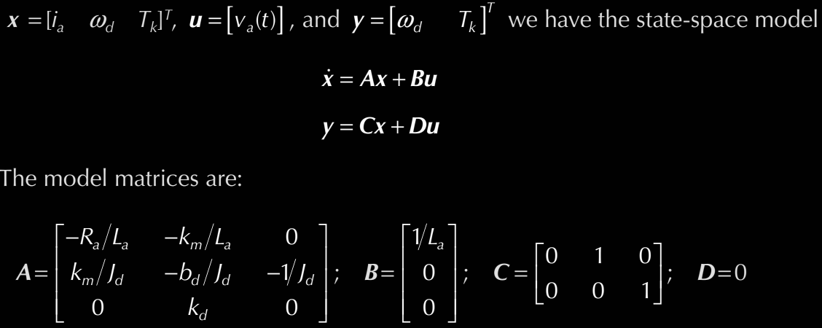
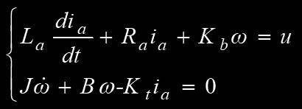

EQUATIONS
Mathematical model:
State-Space Model of a Robotic hand:
Input-output transfer function:

Slide 5
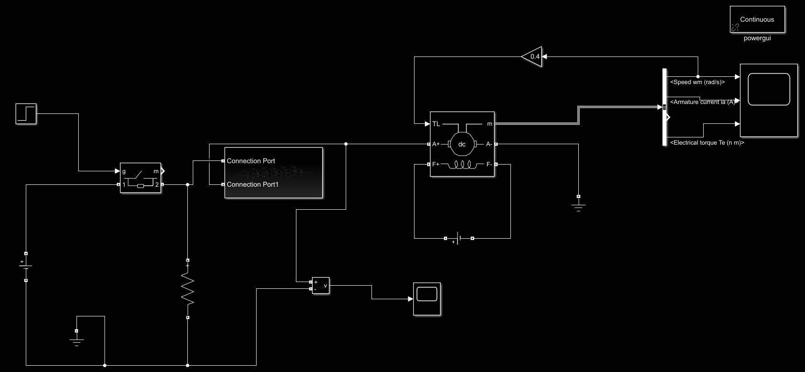
MATLAB SIMULATIONS

Slide 6
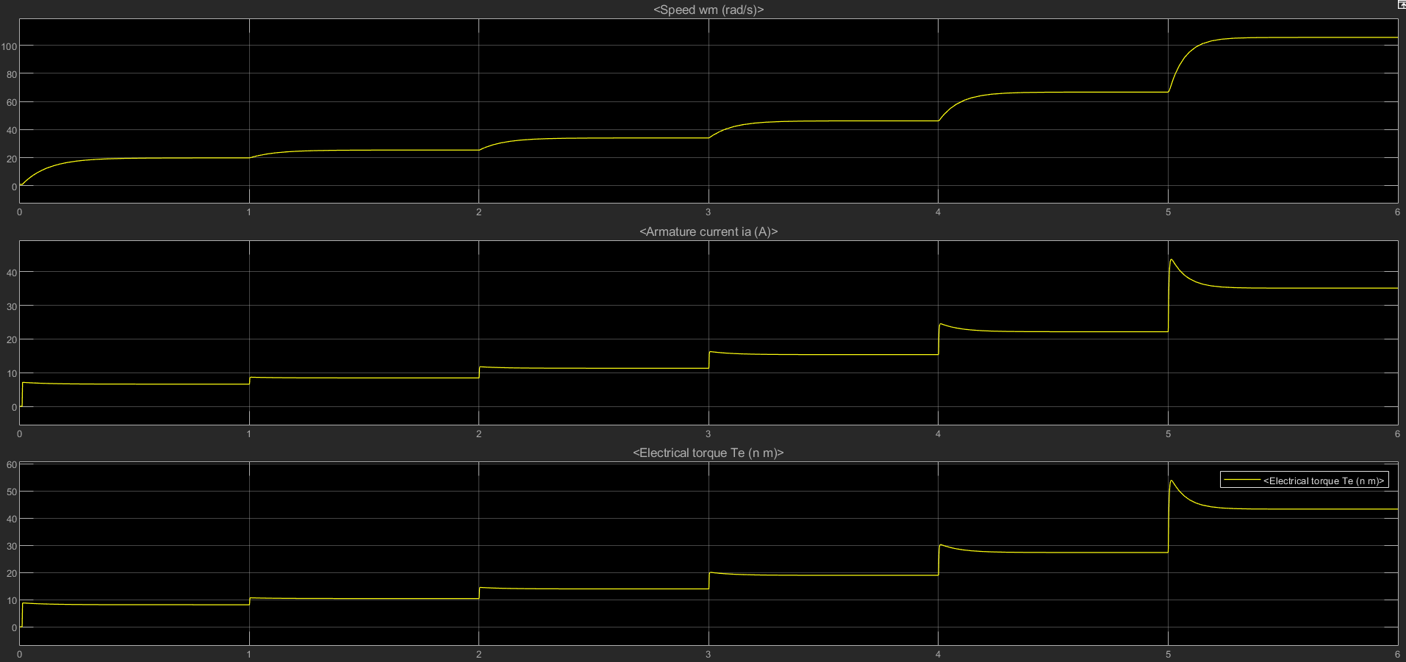
MATLAB SIMULATIONS

Slide 7
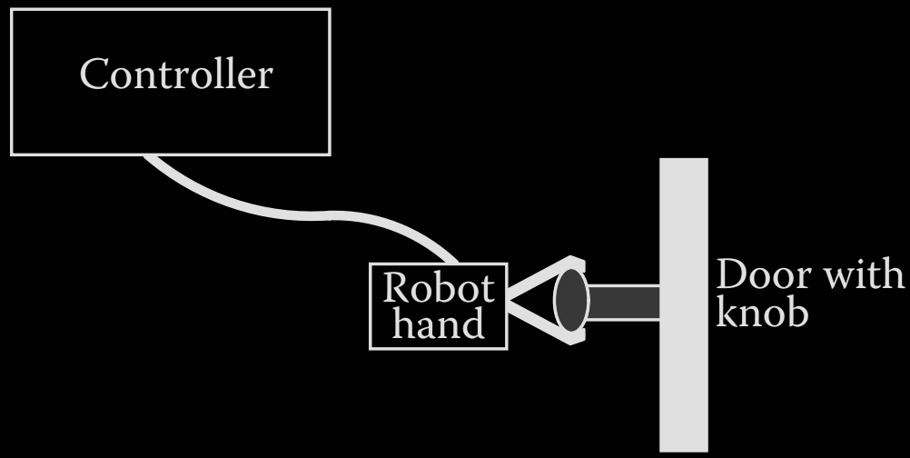
HAND DOOR KNOB SYSTEM
Electrical actuator
Vision Control
Eye in Hand Camera
Pybullet Simulation

Slide 8
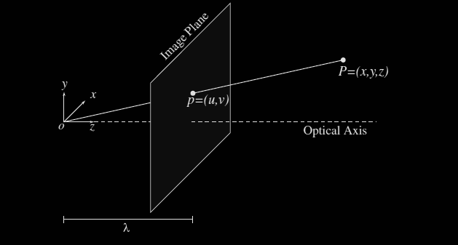
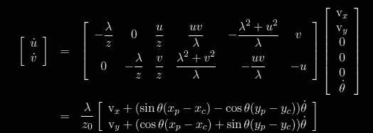
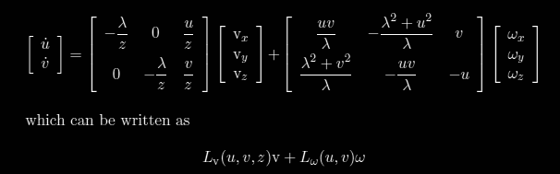
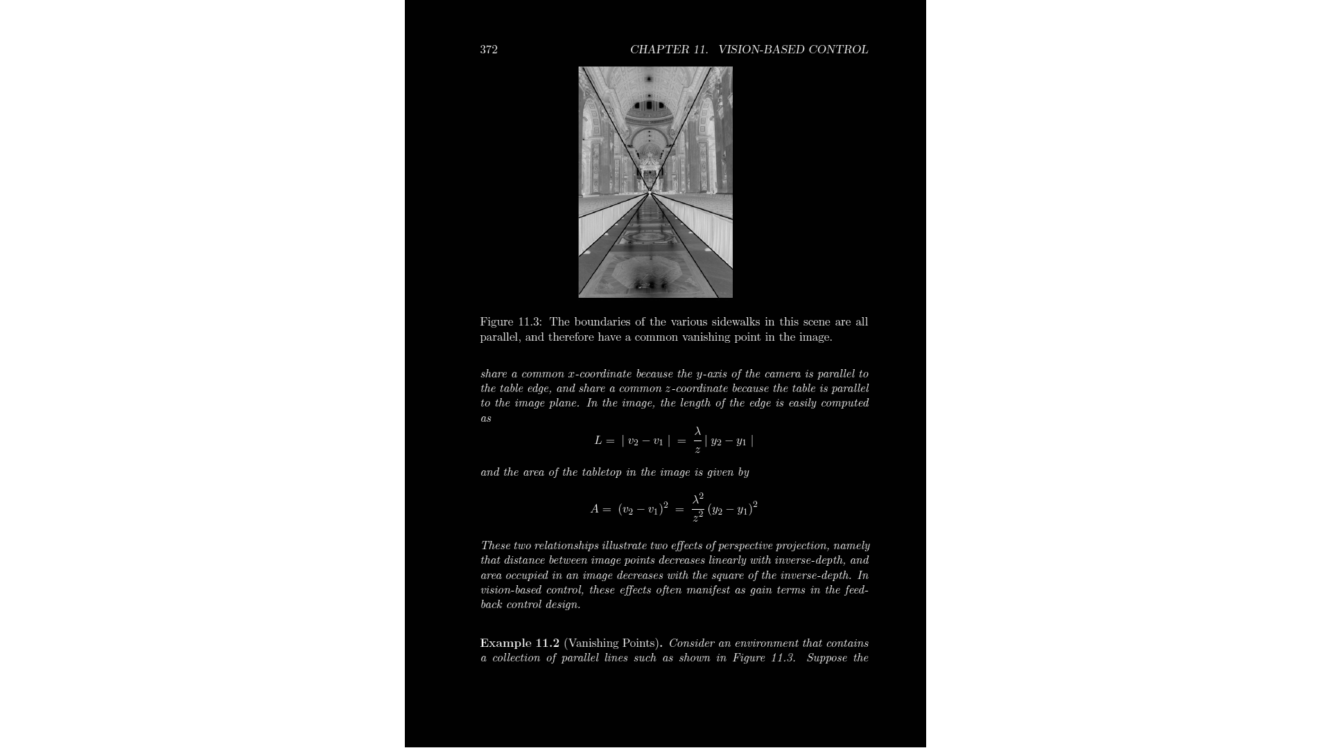
VISION BASED CONTROL

Slide 9
DOOR KNOB GRASPING AND TURNING
Find out through the visual information using mono vision camera mounted.
Estimates the center position of the doorknob for stable grasping.
The door knob position is estimated by a fingertip movement.
Maintain constant grasping force.
The manipulator trajectory for opening door is generated.
Robotic arm grasps the doorknob.
Door knob is turned 180 degree clockwise using fingertips of the arm.

Slide 10
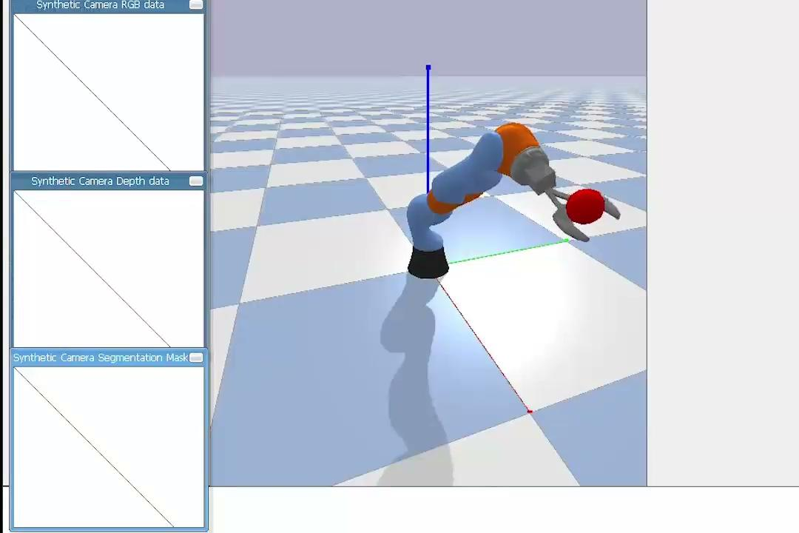
PyBullet SIMULATION

Slide 11
CONCLUSION
In this study, the conceptual framework for hand-manipulator motion coordination is introduced and proved to be much efficient and practical through the simulation verification.
As a confirmatory example, the robot implemented with this motion coordination strategy has performed the doorknob gripping and turning process successfully.
The novel algorithm is proposed to figure out the geometric parameters and are proposed in order to overcome various uncertainties in real environment.

